Slide 1
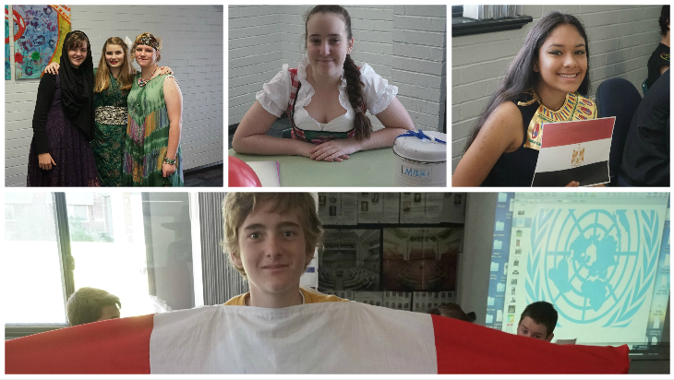
Creating Counter Narratives: The Global Village
Year 9 * Jennifer Florance * Emma Stachowicz

Slide 2
I believe that they need our help, people are dying, children are watching people get murdered and if your country has the resources to help, why wouldn’t you?
(Elyssa Gorski, 2015)
Tranby College Student

Slide 3
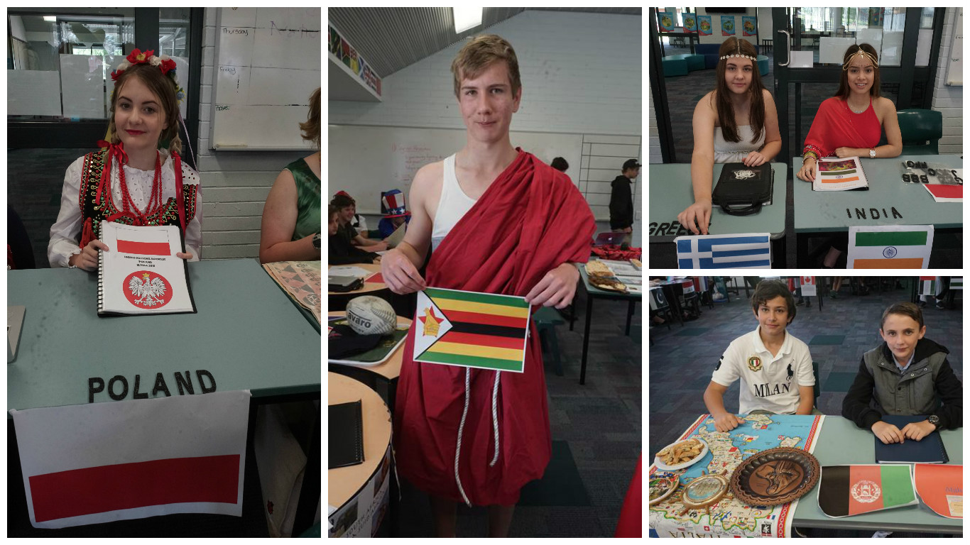
69 STUDENTS. 5 TEACHERS. 4 RESOLUTIONS.

Slide 4
a classroom that encourages opportunity for engagement in societal issues and welcomes the diverse discourses of the classroom, even in the primary grades, takes a major step toward creating an equal platform from which all students can expand their critical literacy skills, broaden their thinking on issues of social consequence, and inaugurate actions that demonstrate proactive global citizenship.
Vetter (2008, p. 93)
Toward a critical stance: Citizenship education in the classroom

Slide 5
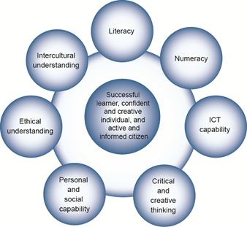
Australian Curriculum Links:
The General Capabilities

Slide 6
History
Geography
Civics & Citizenship
Economics & Business

Slide 7
The Resolutions
The Situation in Iraq & Syria
Towards a Nuclear Weapons Free World
The Ebola Epidemic in West Africa
Towards a New International Economic World Order

